Slide 1
Dag 4: containers in azure
ISAH

Slide 2
Onderwerpen
Azure Container Apps
Azure Container Instance
Azure Container Registry
Azure Kubernetes Service (AKS)

Slide 3






Docker
Operating system
Operating system
Device running virtual machines
Device running containers
Virtual machine
Container
Apps
Services
Kernel
Apps
Services
Kernel
Hardware
Hardware
Notes:
Containers and VMs each have their uses. In fact, many container deployments use VMs as the host operating system rather than running directly on the hardware, especially when running containers in the cloud.
A container is an isolated, lightweight silo for running an application on a host operating system. Containers build on top of a host operating system's kernel, and they contain only apps and some lightweight operating system APIs and services that run in user mode.
In contrast to containers, VMs run complete operating systems, including their own kernels.

Slide 4




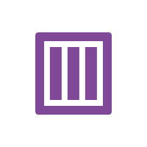

Containers
Linux
Mechanism to package and deploy an application
Operating system
Windows
Application code
Development
Dependencies
Datacenter
Files
Cloud
Notes:
A container is a loosely isolated environment that allows us to build and run software packages. These software packages include the code and all dependencies to run applications quicker and more reliably in most computing environments. These packages are known as container images.
A container image becomes the unit for distributing applications. Software containerization is an operating system virtualization method that you can use to deploy and run containers without using a VM. Containers can run on physical hardware, in the cloud, on VMs, and across multiple operating systems.

Slide 5
Docker
Containerized applications
Containerization platform
Runs "on top of" an operating system
Doesn't require a hypervisor
Runs anywhere
Your desktop/laptop
Server environment
DevOps tools
Cloud services
Infrastructure
Docker
Operating system
Application 1
Application 2
Application 3
Application 4
Application 5
Notes:
Docker is a containerization platform that you can use to develop, ship, and run containers. Docker doesn't use a hypervisor, and you can run it on a desktop or laptop if you're developing and testing applications. The desktop version of Docker supports Linux, Windows, and macOS. For production systems, Docker is available for server environments, including many variants of Linux and Windows Server 2016 and newer versions.
The Docker platform consists of several components that you can use to build, run, and manage containerized applications.

Slide 6
Docker terminology
Container
A standardized "unit of software" that contains everything required for an application to run
Container Image
A template that can be used to create one or more containers
Build
The process of creating a container image using a set of instructions
Pull
The process of downloading a container image from a container registry
Push
The process of uploading a container image to a container registry
Dockerfile
A text file that contains instructions required to build a Docker image.
Notes:
You should be familiar with the following key terms before using Docker and Azure Container Instances to create, build, and test containers:
Container: This is an instance of a Docker image. It represents the execution of a single application, process, or service. It consists of the contents of a Docker image, an execution environment, and a standard set of instructions. When scaling a service, you create multiple instances of a container from the same image. Or a batch job can create multiple containers from the same image, passing different parameters to each instance.
Container image: This refers to a package with all the dependencies and information required to create a container. The dependencies include frameworks and the deployment and execution configuration that a container runtime uses. Usually, an image derives from multiple base images that are layers stacked on top of each other to form the container's file system. An image is immutable once it has been created.
Build: This refers to the action of building a container image based on the information and context provided by its Dockerfile, plus additional files in the folder where the image is built. You can build images by using the Docker docker build command.
Pull: This refers to the process of downloading a container image from a container registry.
Push: This refers to the process of uploading a container image to a container registry.
Dockerfile: This refers to a text file that contains instructions on how to build a Docker image. It's like a batch script; the first line states the base image, followed by instructions to install required programs, copy files, and so on until you get the working environment you need.

Slide 7
Retrieving a new container image from Docker Hub
# Get Ubuntu container image
docker pull ubuntu
# Get version 5.7 of MySQL container image
docker pull mysql:5.7
# Get the latest version of the nginx container image
docker pull nginx:latest
Notes:
Use the docker build command to create the container image and tag it as aci-tutorial-app.
Output from the docker build command is similar to the following (truncated for readability):
$ docker build ./aci-helloworld -t aci-tutorial-app
Sending build context to Docker daemon 119.3kB
Step: FROM node:8.9.3-alpine
8.9.3-alpine: Pulling from library/node
88286f41530e: Pull complete
84f3a4bf8410: Pull complete
d0d9b2214720: Pull complete
Digest: sha256:c73277ccc763752b42bb2400d1aaecb4e3d32e3a9dbedd0e49885c71bea07354
Status: Downloaded newer image for node:8.9.3-alpine
---> 90f5ee24bee2
...
Step: CMD node /usr/src/app/index.js
---> Running in f4a1ea099eec
---> 6edad76d09e9
Removing intermediate container f4a1ea099eec
Successfully built 6edad76d09e9
Successfully tagged aci-tutorial-app:latest
Use the docker images command to examine the built image. Your newly built image should appear in the list:
$ docker images
REPOSITORY TAG IMAGE ID CREATED SIZE
aci-tutorial-app latest 5c745774dfa9 39 seconds ago 68.1 MB

Slide 8
Running the retrieved container image
# Get the .NET application sample container image
docker pull mcr.microsoft.com/dotnet/core/samples:dotnetapp
# Run your container locally
docker run mcr.microsoft.com/dotnet/core/samples:dotnetapp
# View running containers
docker container ls -a
Image name and tag
Notes:
Before deploying a container to Container Instances, use the docker run command to run it locally and confirm that it works. The -d switch lets the container run in the background, while -p allows you to map an arbitrary port on your computer to port 80 in the container.
Output from the docker run command displays the running container's ID if the command is successful:
$ docker run -d -p 8080:80 aci-tutorial-app
A2e3e4435db58ab0c664ce521854c2e1a1bda88c9cf2fcff46aedf48df86cccf

Slide 9
Demonstration: Retrieving and deploying an existing Docker image locally
Notes:
docker pull mcr.microsoft.com/dotnet/core/samples:aspnetapp
docker image list
docker run -d -p 8080:80 mcr.microsoft.com/dotnet/core/samples:aspnetapp
Open a web browser and go to the page for the sample web app at http://localhost:8080
docker ps
docker container stop
docker ps –a
docker container rm
docker ps -a
docker image list
docker image rm mcr.microsoft.com/dotnet/core/samples:aspnetapp
docker image list

Slide 10
Creating a container image specification with a Dockerfile
FROM node:8.9.3-alpine
RUN mkdir -p /usr/src/app
COPY ./app/ /usr/src/app/
WORKDIR /usr/src/app
RUN npm install
CMD node /usr/src/app/index.js
Start with this container image
Run this command
Copy these files from the host
Change the working directory
Start the container with this command
Notes:
The sample application in this tutorial is a simple web app built in Node.js. The application serves a static HTML page, and you can use Git to clone the sample application's repository:
git clone https://github.com/Azure-Samples/aci-helloworld.git
The Dockerfile for an application indicates how the container is built.
The Dockerfile starts from an official Node.js image that’s based on Alpine Linux, a small distribution that’s well suited for use with containers. It then copies the application files into the container, installs dependencies by using the Node Package Manager, and finally, starts the application.

Slide 11
Building the container image
# Build your container
docker build ./application -t tutorial-app
# After building, use the following command to view your new container image
docker images
Path to build
Docker tag
Notes:
Use the docker build command to create the container image and tag it as aci-tutorial-app.
Output from the docker build command is similar to the following (truncated for readability):
$ docker build ./aci-helloworld -t aci-tutorial-app
Sending build context to Docker daemon 119.3kB
Step: FROM node:8.9.3-alpine
8.9.3-alpine: Pulling from library/node
88286f41530e: Pull complete
84f3a4bf8410: Pull complete
d0d9b2214720: Pull complete
Digest: sha256:c73277ccc763752b42bb2400d1aaecb4e3d32e3a9dbedd0e49885c71bea07354
Status: Downloaded newer image for node:8.9.3-alpine
---> 90f5ee24bee2
...
Step: CMD node /usr/src/app/index.js
---> Running in f4a1ea099eec
---> 6edad76d09e9
Removing intermediate container f4a1ea099eec
Successfully built 6edad76d09e9
Successfully tagged aci-tutorial-app:latest
Use the docker images command to examine the built image. Your newly built image should appear in the list:
$ docker images
REPOSITORY TAG IMAGE ID CREATED SIZE
aci-tutorial-app latest 5c745774dfa9 39 seconds ago 68.1 MB

Slide 12
Running the custom container image as a container
# Run your container locally
docker run -d -p 8080:80 tutorial-app
# View running containers
docker container ls -a
Notes:
Before you deploy a container to Container Instances, use the docker run command to run it locally and confirm that it works. The -d switch lets the container run in the background, while -p allows you to map an arbitrary port on your computer to port 80 in the container.
Output from the docker run command displays the running container's ID if the command is successful:
$ docker run -d -p 8080:80 aci-tutorial-app
A2e3e4435db58ab0c664ce521854c2e1a1bda88c9cf2fcff46aedf48df86cccf

Slide 13
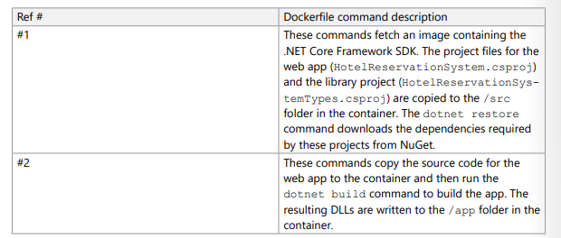
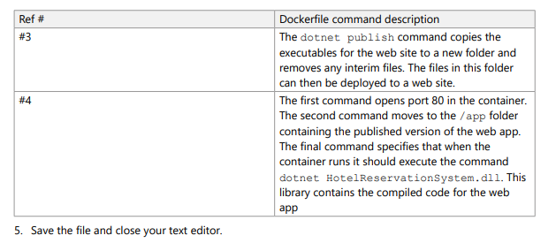
Demonstration: Creating a container image by using Docker
Notes:
git clone https://github.com/MicrosoftDocs/mslearn-hotel-reservation-system.git
cd mslearn-hotel-reservation-system/src
echo "" > Dockerfile
notepad Dockerfile
FROM mcr.microsoft.com/dotnet/core/sdk:2.2
WORKDIR /src
COPY ["HotelReservationSystem/HotelReservationSystem.csproj", "HotelReservationSystem/"]
COPY ["HotelReservationSystemTypes/HotelReservationSystemTypes.csproj", "HotelReservationSystemTypes/"]
RUN dotnet restore "HotelReservationSystem/HotelReservationSystem.csproj“
COPY . .
WORKDIR "/src/HotelReservationSystem"
RUN dotnet build "HotelReservationSystem.csproj" -c Release -o /app
RUN dotnet publish "HotelReservationSystem.csproj" -c Release -o /app
EXPOSE 80
WORKDIR /app
ENTRYPOINT ["dotnet", "HotelReservationSystem.dll“
BUILD AND DEPLOY
docker build -t reservationsystem .
docker image list
docker run -p 8080:80 -d --name reservations reservationsystem
http://localhost:8080/api/reservations/1
docker ps –a
docker container stop reservations
docker rm reservations
docker image rm <image name>

Slide 14
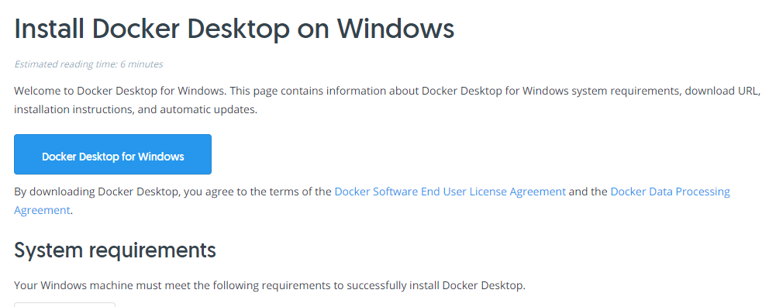
Docker Desktop for Windows
https://docs.docker.com/docker-for-windows/install/

Slide 15
Dockerfile (capital D, small f, no extention)
#publicly available docker image "python" on docker hub will be pulled
FROM python
#creating directory helloworld in container (linux machine)
RUN mkdir c:\home\helloworld
#copying helloworld.py from local directory to container's helloworld folder
COPY helloworld.py /home/helloworld/helloworld.py
#running helloworld.py in container
CMD python /home/helloworld/helloworld.py
Alternative: FROM python:alpine3.7

Slide 16
On your own machine
docker build -t helloworldapp .
docker run helloworldapp
docker run -i helloworldapp

Slide 17
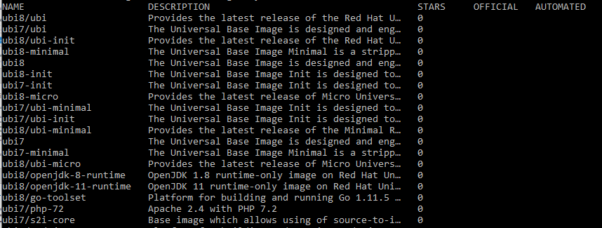
Ubi images from Red Hat
docker search registry.access.redhat.com/ubi

Slide 18
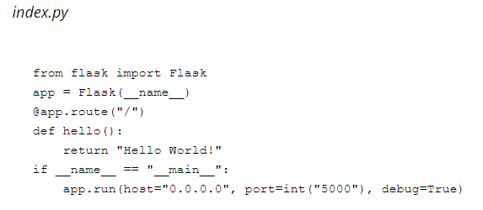
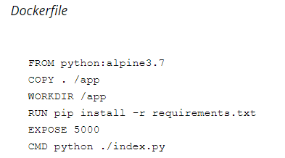
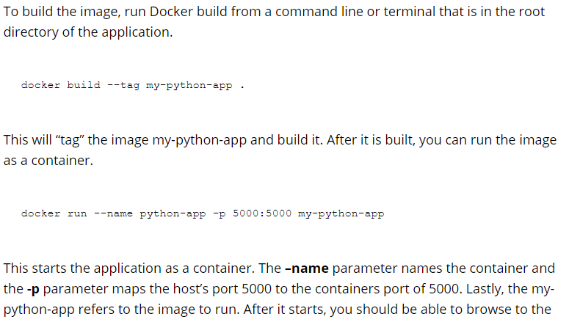
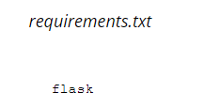

Slide 19
Azure container registry
Azure Container Registry is a managed, private Docker registry service based on the open-source Docker Registry 2.0. Create and maintain Azure container registries to store and manage your private Docker container images and related artifacts.
Use Azure container registries with your existing container development and deployment pipelines, or use Azure Container Registry Tasks to build container images in Azure. Build on demand, or fully automate builds with triggers such as source code commits and base image updates.

Slide 20
Use cases
Pull images from an Azure container registry to various deployment targets:
Scalable orchestration systems that manage containerized applications across clusters of hosts, including Kubernetes, DC/OS, and Docker Swarm.
Azure services that support building and running applications at scale, including Azure Kubernetes Service (AKS), App Service, Batch, Service Fabric, and others.
Developers can also push to a container registry as part of a container development workflow. For example, target a container registry from a continuous integration and delivery tool such as Azure Pipelines or Jenkins.
Configure ACR Tasks to automatically rebuild application images when their base images are updated, or automate image builds when your team commits code to a Git repository. Create multi-step tasks to automate building, testing, and patching multiple container images in parallel in the cloud.
Azure provides tooling including the Azure CLI, the Azure portal, and API support to manage your Azure container registries. Optionally install the Docker Extension for Visual Studio Code and the Azure Account extension to work with your Azure container registries. Pull and push images to an Azure container registry, or run ACR Tasks, all within Visual Studio Code.
Notes:
https://jenkins.io/
https://code.visualstudio.com/docs/azure/docker
https://marketplace.visualstudio.com/items?itemName=ms-vscode.azure-account

Slide 21
Key features
Registry service tiers - Create one or more container registries in your Azure subscription. Registries are available in three tiers: Basic, Standard, and Premium, each of which supports webhook integration, registry authentication with Azure Active Directory, and delete functionality. Take advantage of local, network-close storage of your container images by creating a registry in the same Azure location as your deployments. Use the geo-replication feature of Premium registries for advanced replication and container image distribution scenarios.

Slide 22
Key features
Security and access - You log in to a registry using the Azure CLI or the standard docker login command. Azure Container Registry transfers container images over HTTPS, and supports TLS to secure client connections.
You control access to a container registry using an Azure identity, an Azure Active Directory-backed service principal, or a provided admin account. Use Azure role-based access control (Azure RBAC) to assign users or systems fine-grained permissions to a registry.
Security features of the Premium service tier include content trust for image tag signing, and firewalls and virtual networks (preview) to restrict access to the registry. Microsoft Defender for Cloud optionally integrates with Azure Container Registry to scan images whenever an image is pushed to a registry.
Notes:
https://docs.microsoft.com/en-us/azure/container-registry/container-registry-intro

Slide 23
Key features
Supported images and artifacts - Grouped in a repository, each image is a read-only snapshot of a Docker-compatible container. Azure container registries can include both Windows and Linux images. You control image names for all your container deployments. Use standard Docker commands to push images into a repository, or pull an image from a repository. In addition to Docker container images, Azure Container Registry stores related content formats such as Helm charts and images built to the Open Container Initiative (OCI) Image Format Specification.
Automated image builds - Use Azure Container Registry Tasks (ACR Tasks) to streamline building, testing, pushing, and deploying images in Azure. For example, use ACR Tasks to extend your development inner-loop to the cloud by offloading docker build operations to Azure. Configure build tasks to automate your container OS and framework patching pipeline, and build images automatically when your team commits code to source control.
Notes:
https://docs.microsoft.com/en-us/azure/container-registry/container-registry-tasks-overview
https://docs.docker.com/engine/reference/commandline/
https://github.com/opencontainers/image-spec/blob/master/spec.md
https://docs.microsoft.com/en-us/azure/container-registry/container-registry-tasks-overview

Slide 24
Azure Container Instances
Containers are becoming the preferred way to package, deploy, and manage cloud applications. Azure Container Instances offers the fastest and simplest way to run a container in Azure, without having to manage any virtual machines and without having to adopt a higher-level service.
Azure Container Instances is a great solution for any scenario that can operate in isolated containers, including simple applications, task automation, and build jobs. For scenarios where you need full container orchestration, including service discovery across multiple containers, automatic scaling, and coordinated application upgrades, we recommend Azure Kubernetes Service (AKS).

Slide 25
Fast startup times
Containers offer significant startup benefits over virtual machines (VMs). Azure Container Instances can start containers in Azure in seconds, without the need to provision and manage VMs.
Bring Linux or Windows container images from Docker Hub, a private Azure container registry, or another cloud-based docker registry. Visit the FAQ to learn which registries are supported by ACI. Azure Container Instances caches several common base OS images, helping speed deployment of your custom application images.

Slide 26
Container access
Azure Container Instances enables exposing your container groups directly to the internet with an IP address and a fully qualified domain name (FQDN). When you create a container instance, you can specify a custom DNS name label so your application is reachable at customlabel.azureregion.azurecontainer.io.
Azure Container Instances also supports executing a command in a running container by providing an interactive shell to help with application development and troubleshooting. Access takes places over HTTPS, using TLS to secure client connections.

Slide 27
Compliant deployments
Hypervisor-level security
Historically, containers have offered application dependency isolation and resource governance but have not been considered sufficiently hardened for hostile multi-tenant usage. Azure Container Instances guarantees your application is as isolated in a container as it would be in a VM.
Customer data
The ACI service stores the minimum customer data required to ensure your container groups are running as expected.

Slide 28
Azure container instances
Custom sizes
Containers are typically optimized to run just a single application, but the exact needs of those applications can differ greatly. Azure Container Instances provides optimum utilization by allowing exact specifications of CPU cores and memory. You pay based on what you need and get billed by the second, so you can fine-tune your spending based on actual need.
Persistent storage
To retrieve and persist state with Azure Container Instances, we offer direct mounting of Azure Files shares backed by Azure Storage.

Slide 29
Azure container instances
Linux and Windows containers
Azure Container Instances can schedule both Windows and Linux containers with the same API. Simply specify the OS type when you create your container groups.
Some features are currently restricted to Linux containers:
Multiple containers per container group
Volume mounting (Azure Files, emptyDir, GitRepo, secret)
Resource usage metrics with Azure Monitor
Virtual network deployment
GPU resources (preview)
For Windows container deployments, use images based on common Windows base images.

Slide 30
Azure container instances
Virtual network deployment
Azure Container Instances enables deployment of container instances into an Azure virtual network. When deployed into a subnet within your virtual network, container instances can communicate securely with other resources in the virtual network, including those that are on premises (through VPN gateway or ExpressRoute).

Slide 31
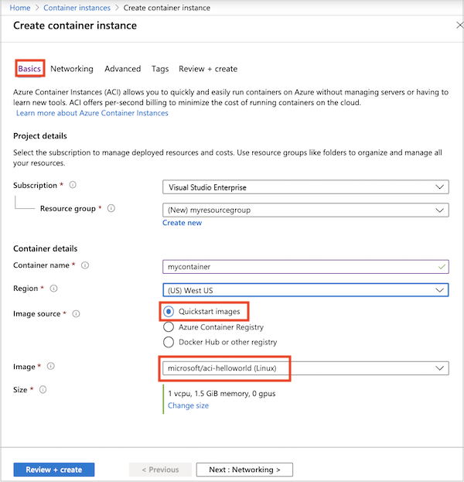
Notes:
https://docs.microsoft.com/en-us/azure/container-instances/container-instances-quickstart-portal

Slide 32
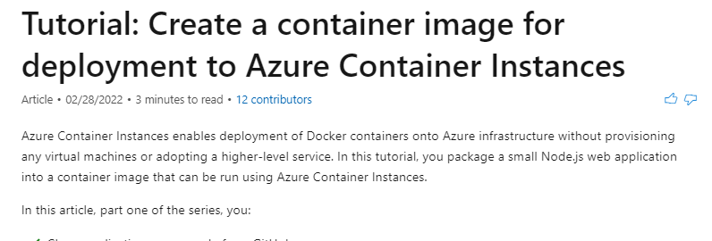
Tutorial: Create a container image for deployment to Azure Container Instances
https://docs.microsoft.com/en-us/azure/container-instances/container-instances-tutorial-prepare-app

Slide 33
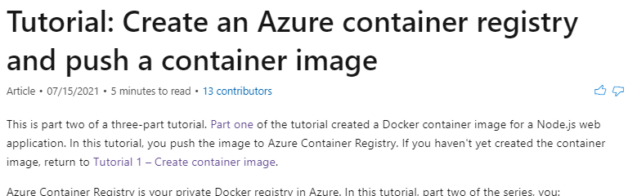
Tutorial: Create an Azure container registry and push a container image
https://docs.microsoft.com/en-us/azure/container-instances/container-instances-tutorial-prepare-acr

Slide 34
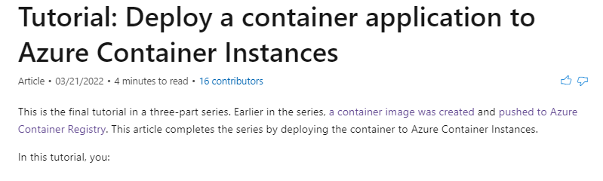
Tutorial: Deploy a container application to Azure Container Instances
https://docs.microsoft.com/en-us/azure/container-instances/container-instances-tutorial-deploy-app

Slide 35
Container groups in Azure Container Instances
A container group is a collection of containers that get scheduled on the same host machine. The containers in a container group share a lifecycle, resources, local network, and storage volumes. It's similar in concept to a pod in

Slide 36
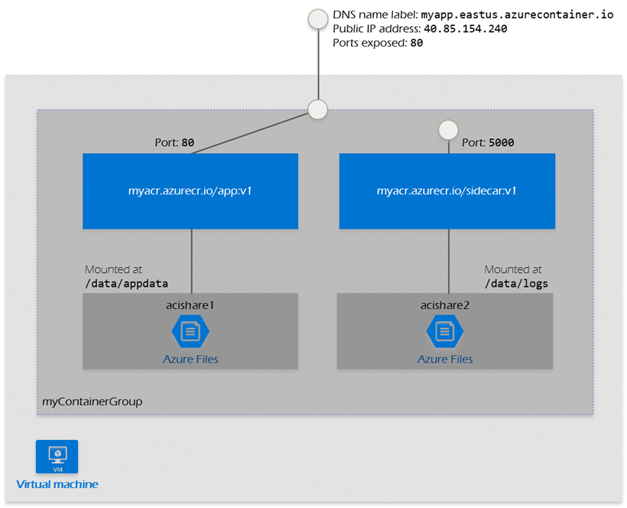

Slide 37
Container groups in Azure Container Instances
This example container group:
Is scheduled on a single host machine.
Is assigned a DNS name label.
Exposes a single public IP address, with one exposed port.
Consists of two containers. One container listens on port 80, while the other listens on port 5000.
Includes two Azure file shares as volume mounts, and each container mounts one of the shares locally.

Slide 38
Deployment
Here are two common ways to deploy a multi-container group: use a Resource Manager template or a YAML file. A Resource Manager template is recommended when you need to deploy additional Azure service resources (for example, an Azure Files share) when you deploy the container instances. Due to the YAML format's more concise nature, a YAML file is recommended when your deployment includes only container instances. For details on properties you can set, see the Resource Manager template reference or YAML reference documentation.
To preserve a container group's configuration, you can export the configuration to a YAML file by using the Azure CLI command az container export. Export allows you to store your container group configurations in version control for "configuration as code." Or, use the exported file as a starting point when developing a new configuration in YAML.
Notes:
https://docs.microsoft.com/en-us/azure/templates/microsoft.containerinstance/containergroups
https://docs.microsoft.com/en-us/azure/container-instances/container-instances-reference-yaml

Slide 39
Resource allocation
Azure Container Instances allocates resources such as CPUs, memory, and optionally GPUs (preview) to a multi-container group by adding the resource requests of the instances in the group. Taking CPU resources as an example, if you create a container group with two container instances, each requesting 1 CPU, then the container group is allocated 2 CPUs.

Slide 40
Resource usage by container instances
Each container instance in a group is allocated the resources specified in its resource request. However, the maximum resources used by a container instance in a group could be different if you configure its optional resource limit property. The resource limit of a container instance must be greater than or equal to the mandatory resource request property.
If you don't specify a resource limit, the container instance's maximum resource usage is the same as its resource request.
If you specify a limit for a container instance, the instance's maximum usage could be greater than the request, up to the limit you set. Correspondingly, resource usage by other container instances in the group could decrease. The maximum resource limit you can set for a container instance is the total resources allocated to the group.
For example, in a group with two container instances each requesting 1 CPU, one of your containers might run a workload that requires more CPUs to run than the other.
In this scenario, you could set a resource limit of up to 2 CPUs for the container instance. This configuration allows the container instance to use up to 2 CPUs if available.

Slide 41
Networking
Container groups can share an external-facing IP address, one or more ports on that IP address, and a DNS label with a fully qualified domain name (FQDN). To enable external clients to reach a container within the group, you must expose the port on the IP address and from the container. A container group's IP address and FQDN are released when the container group is deleted.
Within a container group, container instances can reach each other via localhost on any port, even if those ports aren't exposed externally on the group's IP address or from the container.
Optionally deploy container groups into an Azure virtual network to allow containers to communicate securely with other resources in the virtual network.

Slide 42
Storage
You can specify external volumes to mount within a container group. Supported volumes include:
Azure file share
Secret
Empty directory
Cloned git repo
You can map those volumes into specific paths within the individual containers in a group.

Slide 43
Common scenarios
Multi-container groups are useful in cases where you want to divide a single functional task into a small number of container images. These images can then be delivered by different teams and have separate resource requirements.
Example usage could include:
A container serving a web application and a container pulling the latest content from source control.
An application container and a logging container. The logging container collects the logs and metrics output by the main application and writes them to long-term storage.
An application container and a monitoring container. The monitoring container periodically makes a request to the application to ensure that it's running and responding correctly, and raises an alert if it's not.
A front-end container and a back-end container. The front end might serve a web application, with the back end running a service to retrieve data.

Slide 44
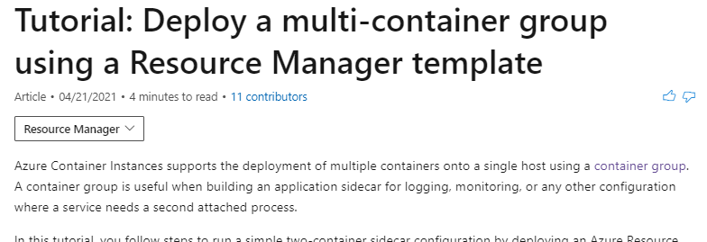
Tutorial: Deploy a multi-container group using a Resource Manager template
https://docs.microsoft.com/en-us/azure/container-instances/container-instances-multi-container-group

Slide 45
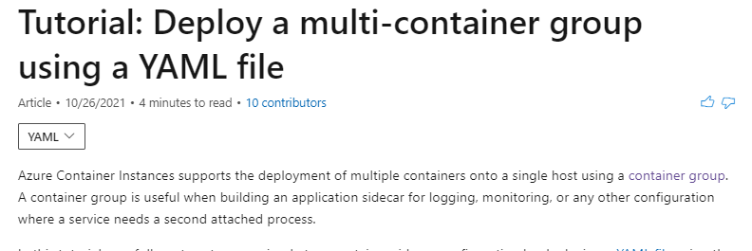
Tutorial: Deploy a multi-container group using a YAML file
https://docs.microsoft.com/en-us/azure/container-instances/container-instances-multi-container-yaml

Slide 47
kubernetes
Manages container-based applications
Along with networking and storage requirements
Focused on application workloads instead of infrastructure components
Makes it easier to orchestrate large solutions using a variety of containers
Application containers
Storage containers
Middleware containers
Even more…
Applications are described declaratively
Use YAML files to describe application
Kubernetes handles management and deployment
Notes:
Kubernetes is a rapidly evolving platform that manages container-based applications and their associated networking and storage components. The focus is on the application workloads, not the underlying infrastructure components. Kubernetes provides a declarative approach to deployments, backed by a robust set of APIs for management operations.
You can build and run modern, portable, microservices-based applications that benefit from Kubernetes orchestrating and managing the availability of those application components. Kubernetes supports both stateless and stateful applications as teams progress through the adoption of microservices-based applications.
As an open platform, Kubernetes allows you to build your applications with your preferred programming language, OS, libraries, or messaging bus. Existing continuous integration and continuous delivery (CI/CD) tools can integrate with Kubernetes to schedule and deploy releases.

Slide 48
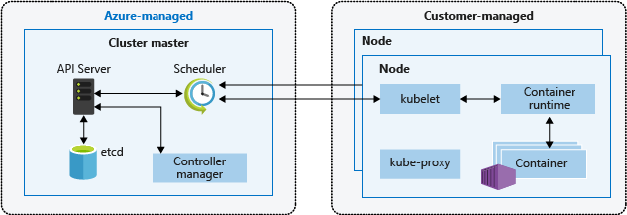
Kubernetes cluster architecture
Cluster master
Dedicated nodes provide core Kubernetes services and orchestration
Nodes
Run application workloads
Notes:
A Kubernetes cluster is divided into two components:
Cluster master nodes provide the core Kubernetes services and orchestration of application workloads.
Nodes run your application workloads.
Cluster master
When you create an AKS cluster, a cluster master is automatically created and configured. This cluster master is provided as a managed Azure resource abstracted from the user. There is no cost for the cluster master, only the nodes that are part of the AKS cluster.
Nodes and node pools
To run your applications and supporting services, you need a Kubernetes node. An AKS cluster has one or more nodes, which is an Azure virtual machine (VM) that runs the Kubernetes node components and container runtime.

Slide 49
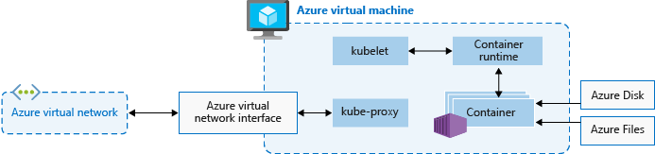
Kubernetes nodes
Each individual node is an Azure virtual machine (VM )
Contains Kubernetes node components needed to communicate with the cluster master and the internet
Contains the container runtime for your applications
In Azure Kubernetes Service, Docker is the container runtime
Notes:
The kubelet is the Kubernetes agent that processes the orchestration requests from the cluster master and scheduling of running the requested containers.
Virtual networking is handled by the kube-proxy on each node. The proxy routes network traffic and manages IP addressing for services and pods.
The container runtime is the component that allows containerized applications to run and interact with additional resources such as the virtual network and storage. In AKS, Docker is used as the container runtime.

Slide 50
Kubernetes terminology
Nodes
Individual VM running containerized applications
Pools
Groups of nodes with identical configurations
Pods
Single instance of an application
It’s possible for a pod to contain multiple containers within the same node
Deployments
One or more identical pods managed by Kubernetes
Manifests
YAML file describing a deployment
Notes:
Nodes
An AKS cluster has one or more nodes, which is an Azure virtual machine (VM) that runs the Kubernetes node components and container runtime.
In AKS, the VM image for the nodes in your cluster is currently based on Ubuntu Linux. When you create an AKS cluster or scale up the number of nodes, the Azure platform creates the requested number of VMs and configures them. There is no manual configuration for you to perform.
Node pools
Nodes of the same configuration are grouped together into node pools. A Kubernetes cluster contains one or more node pools. The initial number of nodes and size are defined when you create an AKS cluster, which creates a default node pool. This default node pool in AKS contains the underlying VMs that run your agent nodes.
Pods
Kubernetes uses pods to run an instance of your application. A pod represents a single instance of your application. Pods typically have a 1:1 mapping with a container, although there are advanced scenarios where a pod may contain multiple containers. These multi-container pods are scheduled together on the same node, and allow containers to share related resources.
A pod is a logical resource, but the container(s) are where the application workloads run. Pods are typically ephemeral, disposable resources, and individually scheduled pods miss some of the high availability and redundancy features that Kubernetes provides. Instead, pods are usually deployed and managed by Kubernetes Controllers, such as the Deployment Controller.
Manifests
A YAML file describing a deployment.
Deployments
A deployment represents one or more identical pods, managed by the Kubernetes Deployment Controller. A deployment defines the number of replicas (pods) to create, and the Kubernetes Scheduler ensures that if pods or nodes encounter problems, additional pods are scheduled on healthy nodes.
You can update deployments to change the configuration of pods, container image used, or attached storage. The Deployment Controller drains and terminates a given number of replicas, creates replicas from the new deployment definition, and continues the process until all replicas in the deployment are updated.

Slide 51
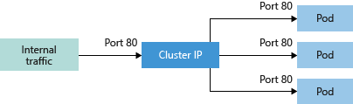
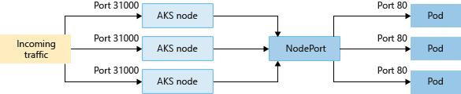
Networking connectivity
Services group pods together to provide network connectivity
Cluster IP
Creates internal-only IP address for use within the cluster
NodePort
Creates a port mapping on a specific node for direct access
Notes:
To simplify the network configuration for application workloads, Kubernetes uses Services to logically group a set of pods together and provide network connectivity. The following service types are available:
Cluster IP
Creates an internal IP address for use within the AKS cluster. Good for internal-only applications that support other workloads within the cluster.
NodePort
Creates a port mapping on the underlying node that allows the application to be accessed directly with the node IP address and port.

Slide 52
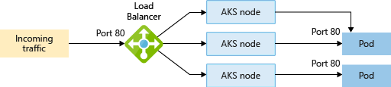
Networking connectivity (continued)
Services group pods together to provide network connectivity
LoadBalancer
Creates an Azure load balancer resource with an external IP address
ExternalName
Creates a direct DNS entry
Notes:
To simplify the network configuration for application workloads, Kubernetes uses Services to logically group a set of pods together and provide network connectivity. The following Service types are available:
LoadBalancer
Creates an Azure load balancer resource, configures an external IP address, and connects the requested pods to the load balancer back-end pool. To allow customers traffic to reach the application, load balancing rules are created on the desired ports.
ExternalName
Creates a specific DNS entry for easier application access.

Slide 53
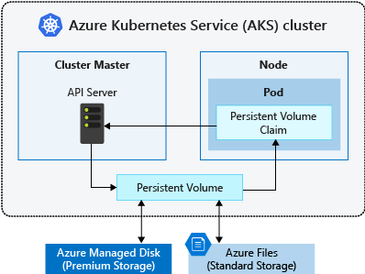
Storage
Local storage on the node is fast and simple to use
Local storage might not be available after the pod is deleted
Multiple pods may share data volumes
Storage could potentially be reattached to another pod
Notes:
Applications that run in Azure Kubernetes Service (AKS) may need to store and retrieve data. For some application workloads, this data storage can use local, fast storage on the node that is no longer needed when the pods are deleted. Other application workloads might require storage that persists on more regular data volumes within the Azure platform. Multiple pods might need to share the same data volumes, or reattach data volumes if the pod is rescheduled on a different node. Finally, you might need to inject sensitive data or application configuration information into pods.

Slide 54
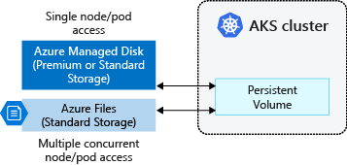
Persistent storage volumes
Pods can use storage that is persistent
Storage exists beyond the lifetime of the pod
Storage can be a service such as Azure Files or an Azure Managed Disk
Notes:
Volumes are defined and created as part of the pod lifecycle and only exist until the pod is deleted. Pods often expect their storage to remain if a pod is rescheduled on a different host during a maintenance event, especially in StatefulSets. A persistent volume (PV) is a storage resource created and managed by the Kubernetes API that can exist beyond the lifetime of an individual pod.
Azure Disks or Files are used to provide the PersistentVolume. As noted in the previous section on Volumes, the choice of Disks or Files is often determined by the need for concurrent access to the data or the performance tier.

Slide 55
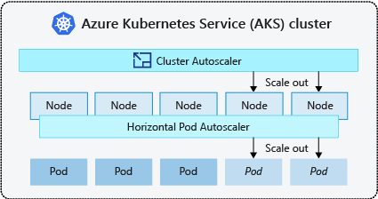
Scaling
Applications might grow beyond the capacity of a single pod
Kubernetes has built-in autoscalers to automatically create instances when they are needed
Horizontal pod autoscaler
Automatically scale replicas based on metrics
Cluster Autoscaler
Adjusts the number of nodes based on the requested compute resources
Notes:
As you run applications in AKS, you might need to increase or decrease the amount of compute resources. As the number of application instances you need change, the number of underlying Kubernetes nodes might also need to change. You also might need to quickly provision a large number of additional application instances.
Horizontal pod autoscaler
Kubernetes uses the horizontal pod autoscaler (HPA) to monitor the resource demand and automatically scale the number of replicas. By default, the horizontal pod autoscaler checks the Metrics API every 30 seconds for any required changes in replica count. When changes are required, the number of replicas is increased or decreased accordingly.
Cluster autoscaler
To respond to changing pod demands, Kubernetes has a cluster autoscaler that adjusts the number of nodes based on the requested compute resources in the node pool. By default, the cluster autoscaler checks the API server every 10 seconds for any required changes in node count. If the cluster autoscale determines that a change is required, the number of nodes in your AKS cluster is increased or decreased accordingly.

Slide 56
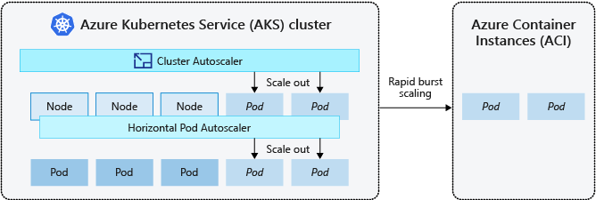
Scaling to Azure Container Instances
If you need to rapidly grow your AKS cluster, you can create new pods in Azure Container Instances (ACI)
Notes:
Burst to Azure Container Instances
To rapidly scale your AKS cluster, you can integrate with Azure Container Instances (ACI). Kubernetes has built-in components to scale the replica and node count. However, if your application needs to scale rapidly, the horizontal pod autoscaler may schedule more pods than can be provided by the existing compute resources in the node pool. If configured, this scenario would then trigger the cluster autoscaler to deploy additional nodes in the node pool, but it might take a few minutes for those nodes to successfully provision and allow the Kubernetes scheduler to run pods on them.

Slide 57
Azure Kubernetes Service (AKS)
Azure Kubernetes Service (AKS) simplifies deploying a managed Kubernetes cluster in Azure by offloading the operational overhead to Azure. As a hosted Kubernetes service, Azure handles critical tasks, like health monitoring and maintenance. Since Kubernetes masters are managed by Azure, you only manage and maintain the agent nodes. Thus, AKS is free; you only pay for the agent nodes within your clusters, not for the masters.
You can create an AKS cluster using:
The Azure CLI
The Azure portal
Azure PowerShell
Using template-driven deployment options, like Azure Resource Manager templates, Bicep and Terraform.

Slide 58
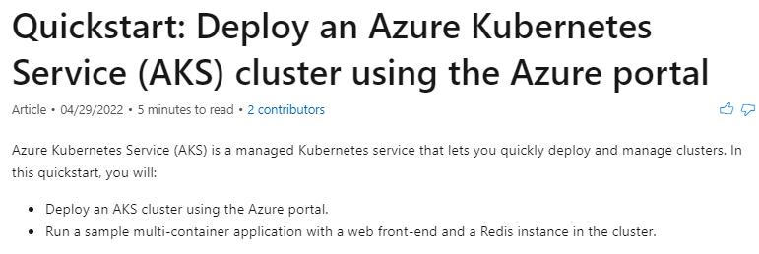
Quickstart: Deploy an Azure Kubernetes Service (AKS) cluster using the Azure portal
https://docs.microsoft.com/en-us/azure/aks/learn/quick-kubernetes-deploy-portal

Slide 59
Access, security, and monitoring
For improved security and management, AKS lets you integrate with Azure AD to:
Use Kubernetes role-based access control (Kubernetes RBAC).
Monitor the health of your cluster and resources.

Slide 60
Kubernetes RBAC
Kubernetes RBAC provides granular filtering of user actions. With this control mechanism:
You assign users or user groups permission to create and modify resources or view logs from running application workloads.
You can scope permissions to a single namespace or across the entire AKS cluster.
You create roles to define permissions, and then assign those roles to users with role bindings.

Slide 61
Azure AD
You can configure an AKS cluster to integrate with Azure AD. With Azure AD integration, you can set up Kubernetes access based on existing identity and group membership. Your existing Azure AD users and groups can be provided with an integrated sign-on experience and access to AKS resources.
Notes:
https://docs.microsoft.com/en-us/azure/aks/azure-ad-integration-cli

Slide 62
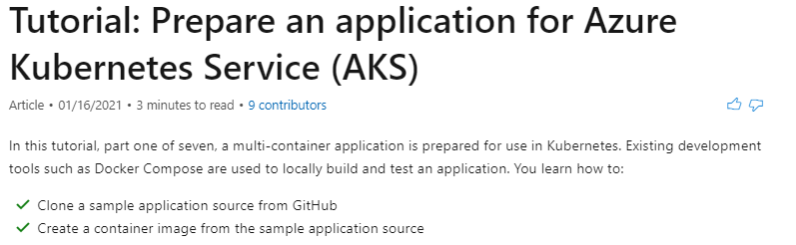
Tutorial: Prepare an application for Azure Kubernetes Service (AKS)
https://docs.microsoft.com/en-us/azure/aks/tutorial-kubernetes-prepare-app

Slide 63
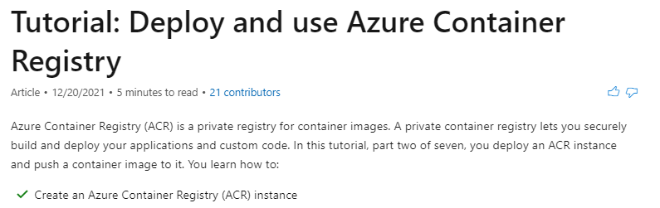
Tutorial: Deploy and use Azure Container Registry
https://docs.microsoft.com/en-us/azure/aks/tutorial-kubernetes-prepare-acr?tabs=azure-cli

Slide 64
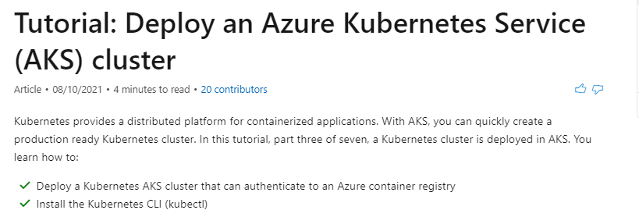
Tutorial: Deploy an Azure Kubernetes Service (AKS) cluster
https://docs.microsoft.com/en-us/azure/aks/tutorial-kubernetes-deploy-cluster?tabs=azure-cli

Slide 65
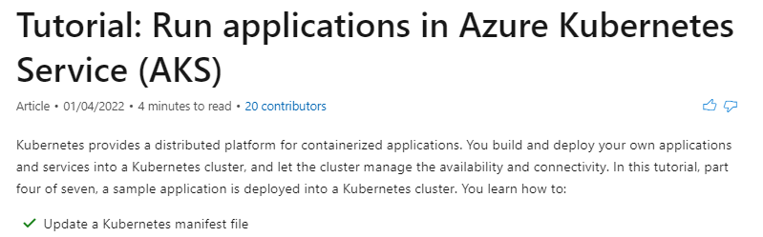
Tutorial: Run applications in Azure Kubernetes Service (AKS)
https://docs.microsoft.com/en-us/azure/aks/tutorial-kubernetes-deploy-application?tabs=azure-cli

Slide 66
Aks scaling
If the resource needs of your applications change, you can manually scale an AKS cluster to run a different number of nodes. When you scale down, nodes are carefully cordoned and drained to minimize disruption to running applications. When you scale up, AKS waits until nodes are marked Ready by the Kubernetes cluster before pods are scheduled on them.
Notes:
https://kubernetes.io/docs/tasks/administer-cluster/safely-drain-node/

Slide 67
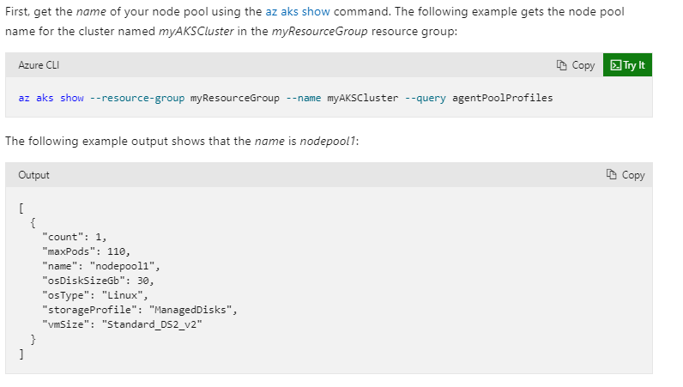
Aks scaling

Slide 68
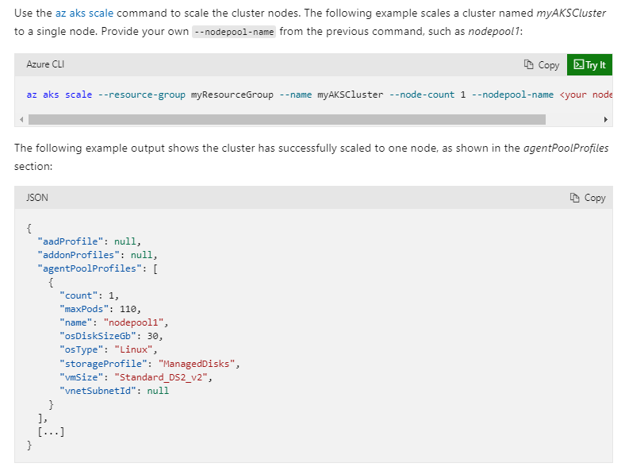

Slide 69
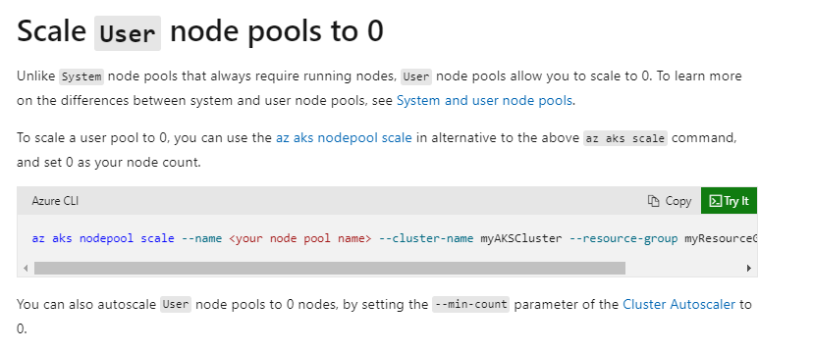
Aks scaling

Slide 70
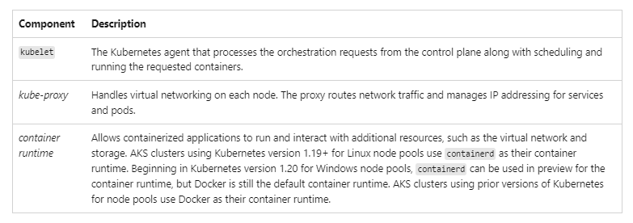
Node and node pools
To run your applications and supporting services, you need a Kubernetes node. An AKS cluster has at least one node, an Azure virtual machine (VM) that runs the Kubernetes node components and container runtime.
Notes:
https://docs.microsoft.com/en-us/azure/aks/concepts-clusters-workloads

Slide 71
The Azure VM size for your nodes defines the storage CPUs, memory, size, and type available (such as high-performance SSD or regular HDD). Plan the node size around whether your applications may require large amounts of CPU and memory or high-performance storage. Scale out the number of nodes in your AKS cluster to meet demand.
In AKS, the VM image for your cluster's nodes is based on Ubuntu Linux or Windows Server 2019. When you create an AKS cluster or scale out the number of nodes, the Azure platform automatically creates and configures the requested number of VMs. Agent nodes are billed as standard VMs, so any VM size discounts (including Azure reservations) are automatically applied.
If you need advanced configuration and control on your Kubernetes node container runtime and OS, you can deploy a self-managed cluster using Cluster API Provider Azure
Notes:
https://github.com/kubernetes-sigs/cluster-api-provider-azure

Slide 72

Resource reservations
AKS uses node resources to help the node function as part of your cluster. This usage can create a discrepancy between your node's total resources and the allocatable resources in AKS. Remember this information when setting requests and limits for user deployed pods.
To find a node's allocatable resources, run:
To maintain node performance and functionality, AKS reserves resources on each node. As a node grows larger in resources, the resource reservation grows due to a higher need for management of user-deployed pods.

Slide 73
Two types of resources are reserved:
CPU
Reserved CPU is dependent on node type and cluster configuration, which may cause less allocatable CPU due to running additional features.
Memory
Memory utilized by AKS includes the sum of two values.
kubelet daemon
The kubelet daemon is installed on all Kubernetes agent nodes to manage container creation and termination.
By default on AKS, kubelet daemon has the memory.available<750Mi eviction rule, ensuring a node must always have at least 750 Mi allocatable at all times. When a host is below that available memory threshold, the kubelet will trigger to terminate one of the running pods and free up memory on the host machine.
A regressive rate of memory reservations for the kubelet daemon to properly function (kube-reserved).
25% of the first 4 GB of memory
20% of the next 4 GB of memory (up to 8 GB)
10% of the next 8 GB of memory (up to 16 GB)
6% of the next 112 GB of memory (up to 128 GB)
2% of any memory above 128 GB

Slide 74
Memory and CPU allocation rules:
Keep agent nodes healthy, including some hosting system pods critical to cluster health.
Cause the node to report less allocatable memory and CPU than it would if it were not part of a Kubernetes cluster.
The above resource reservations can't be changed.
For example, if a node offers 7 GB, it will report 34% of memory not allocatable including the 750Mi hard eviction threshold.
0.75 + (0.25*4) + (0.20*3) = 0.75GB + 1GB + 0.6GB = 2.35GB / 7GB = 33.57% reserved
In addition to reservations for Kubernetes itself, the underlying node OS also reserves an amount of CPU and memory resources to maintain OS functions.
For associated best practices, see Best practices for basic scheduler features in AKS.
Notes:
https://docs.microsoft.com/en-us/azure/aks/operator-best-practices-scheduler

Slide 75
Node pools
Nodes of the same configuration are grouped together into node pools. A Kubernetes cluster contains at least one node pool. The initial number of nodes and size are defined when you create an AKS cluster, which creates a default node pool. This default node pool in AKS contains the underlying VMs that run your agent nodes.
ou scale or upgrade an AKS cluster against the default node pool. You can choose to scale or upgrade a specific node pool. For upgrade operations, running containers are scheduled on other nodes in the node pool until all the nodes are successfully upgraded.
For more information about how to use multiple node pools in AKS, see Create and manage multiple node pools for a cluster in AKS.
Notes:
https://docs.microsoft.com/en-us/azure/aks/use-multiple-node-pools

Slide 76
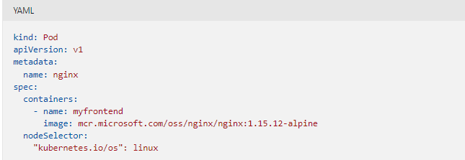
Node selectors
In an AKS cluster with multiple node pools, you may need to tell the Kubernetes Scheduler which node pool to use for a given resource. For example, ingress controllers shouldn't run on Windows Server nodes.
Node selectors let you define various parameters, like node OS, to control where a pod should be scheduled.
The following basic example schedules an NGINX instance on a Linux node using the node selector "kubernetes.io/os": linux:

Slide 77
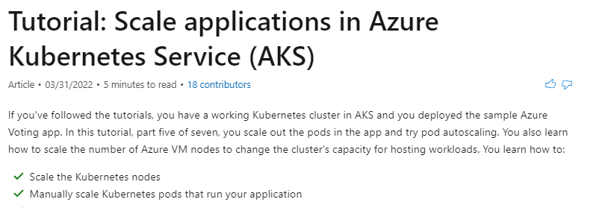
Tutorial: Scale applications in Azure Kubernetes Service (AKS)
https://docs.microsoft.com/en-us/azure/aks/tutorial-kubernetes-scale?tabs=azure-cli

Slide 78
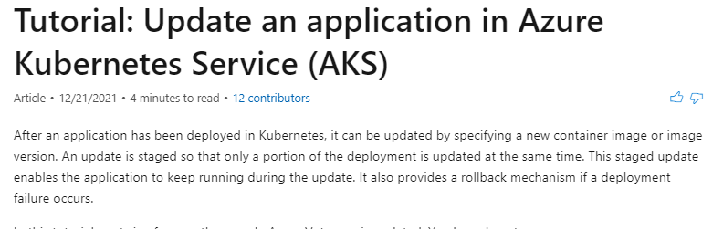
Tutorial: Update an application in Azure Kubernetes Service (AKS)
https://docs.microsoft.com/en-us/azure/aks/tutorial-kubernetes-app-update?tabs=azure-cli

Slide 79
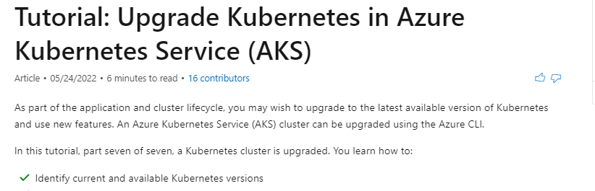
Tutorial: Upgrade Kubernetes in Azure Kubernetes Service (AKS)
https://docs.microsoft.com/en-us/azure/aks/tutorial-kubernetes-upgrade-cluster?tabs=azure-cli

Slide 80
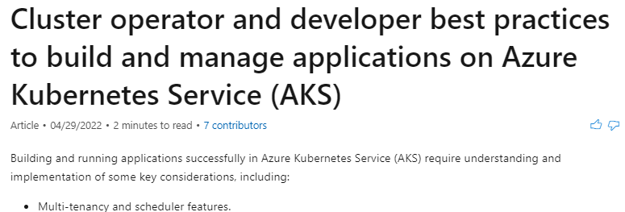
Best practices
https://docs.microsoft.com/en-us/azure/aks/best-practices
Notes:
https://docs.microsoft.com/en-us/azure/aks/best-practices

